Slide 1
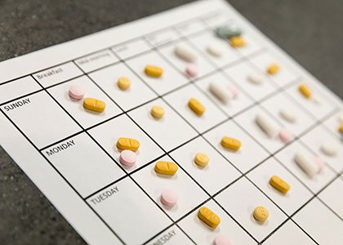

MGT 501 Agile Project Management Summer 2024 Group Project
MediTrack: Medication Adherence Tool
Presented by:
Amrita Thapa (20162)
Daria Kuznetsova(20186)
Nilisha Pradhan (19912)
Persabel Tesfay (20127)
Muskan Arora(19972)
Eno Inwang (19868)

Slide 2
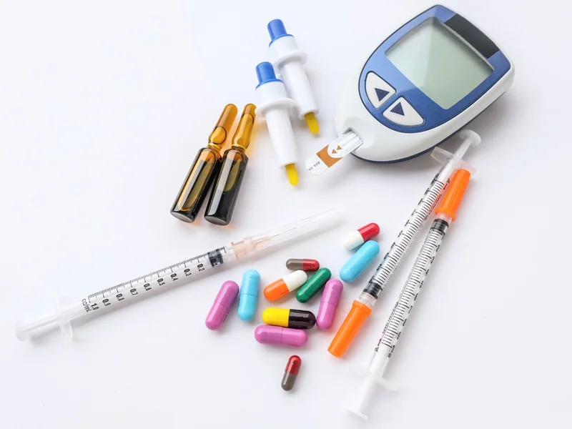

Introduction
Diabetic patients’ struggles:
-medication regimens complexity
-forgetting to take medications
-taking incorrect doses
-accidentally taking multiple doses
Our mission, their solution:
Provide a safe, easy-to-use instrument that offers prompt reminders, instructional materials, and smooth integration with medical systems.

Slide 3
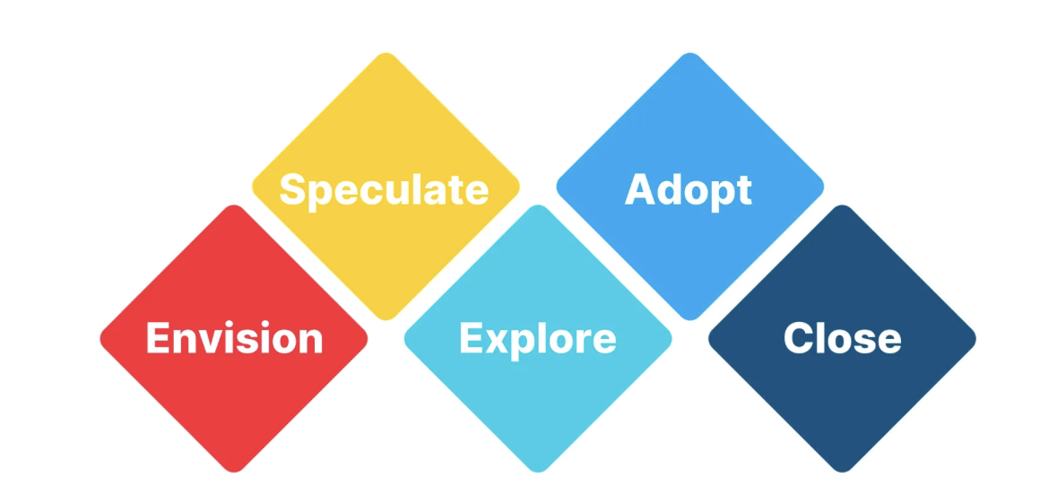
Executive summary
Deliverables: The project will be executed using Agile methodology, focusing on key features in successive sprints:
Sprint 1: User authentication and profile creation.
Sprint 2: Medication schedule setup interface.
Sprint 3: Reminder system development.
Sprint 4: Adherence tracking and reporting.
Sprint 5: Educational resources integration.
Sprint 6: API development for healthcare system integration.
Objectives:
Enhance medication adherence and patient education
Ensure a secure and integrated user experience
Enable continuous improvement and support

Slide 4
Project scope
Project Goal: To help users remember to take the right medication, the right way, at the right time.
User Needs: designed to cater to diabetic patients who have a hard time complying with their medication schedules.
Design Inputs: requires basic information about each medication the user takes
Design Outputs: provides reminders on a daily/weekly/monthly schedule.
Design Verification and Validation:tracks the remaining quantities, sends refill reminders, and logs medication adherence.
Iterative Development and Testing: iterative development and testing, with each iteration improving upon the last based on user feedback and testing results

Slide 5
Assumptions
Constraints
User Engagement
Health Literacy
Technological Accessibility
Healthcare Integration
Behavioral Factors
Data Privacy and Security
Measurable Outcomes
Cost-Effectiveness
Data security risk
Legal risk
Market risk
Stakeholder risk
Development operation risk

Slide 6
Envision phase
MediTrack is a cutting-edge tool designed to improve the health outcomes of diabetic patients.
Automates reminders, provides educational resources, and integrates with healthcare systems.
Empowers patients, supports caregivers, and facilitates better patient monitoring.

Slide 7
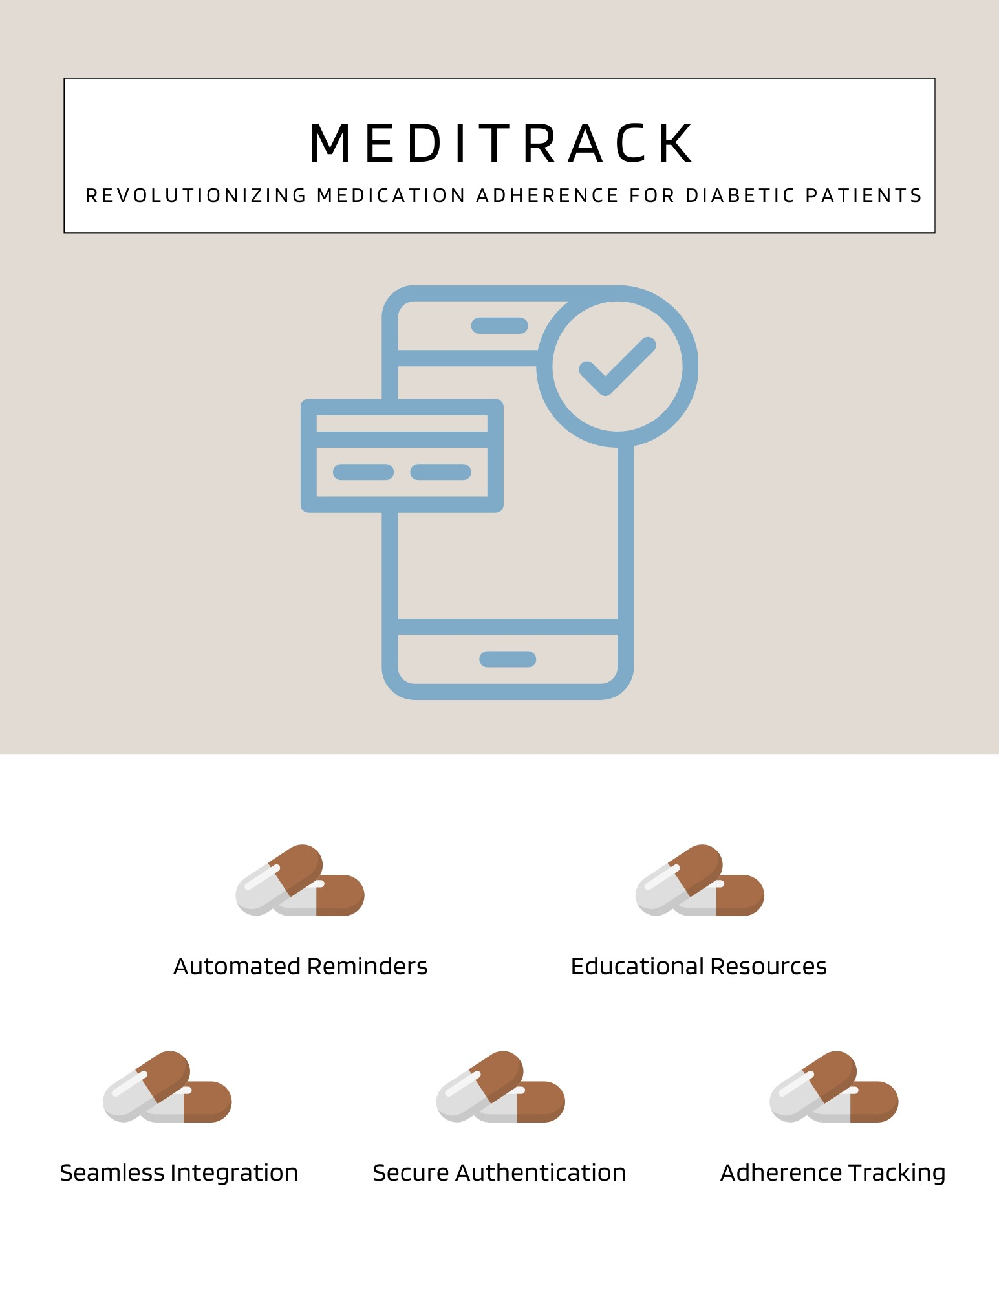
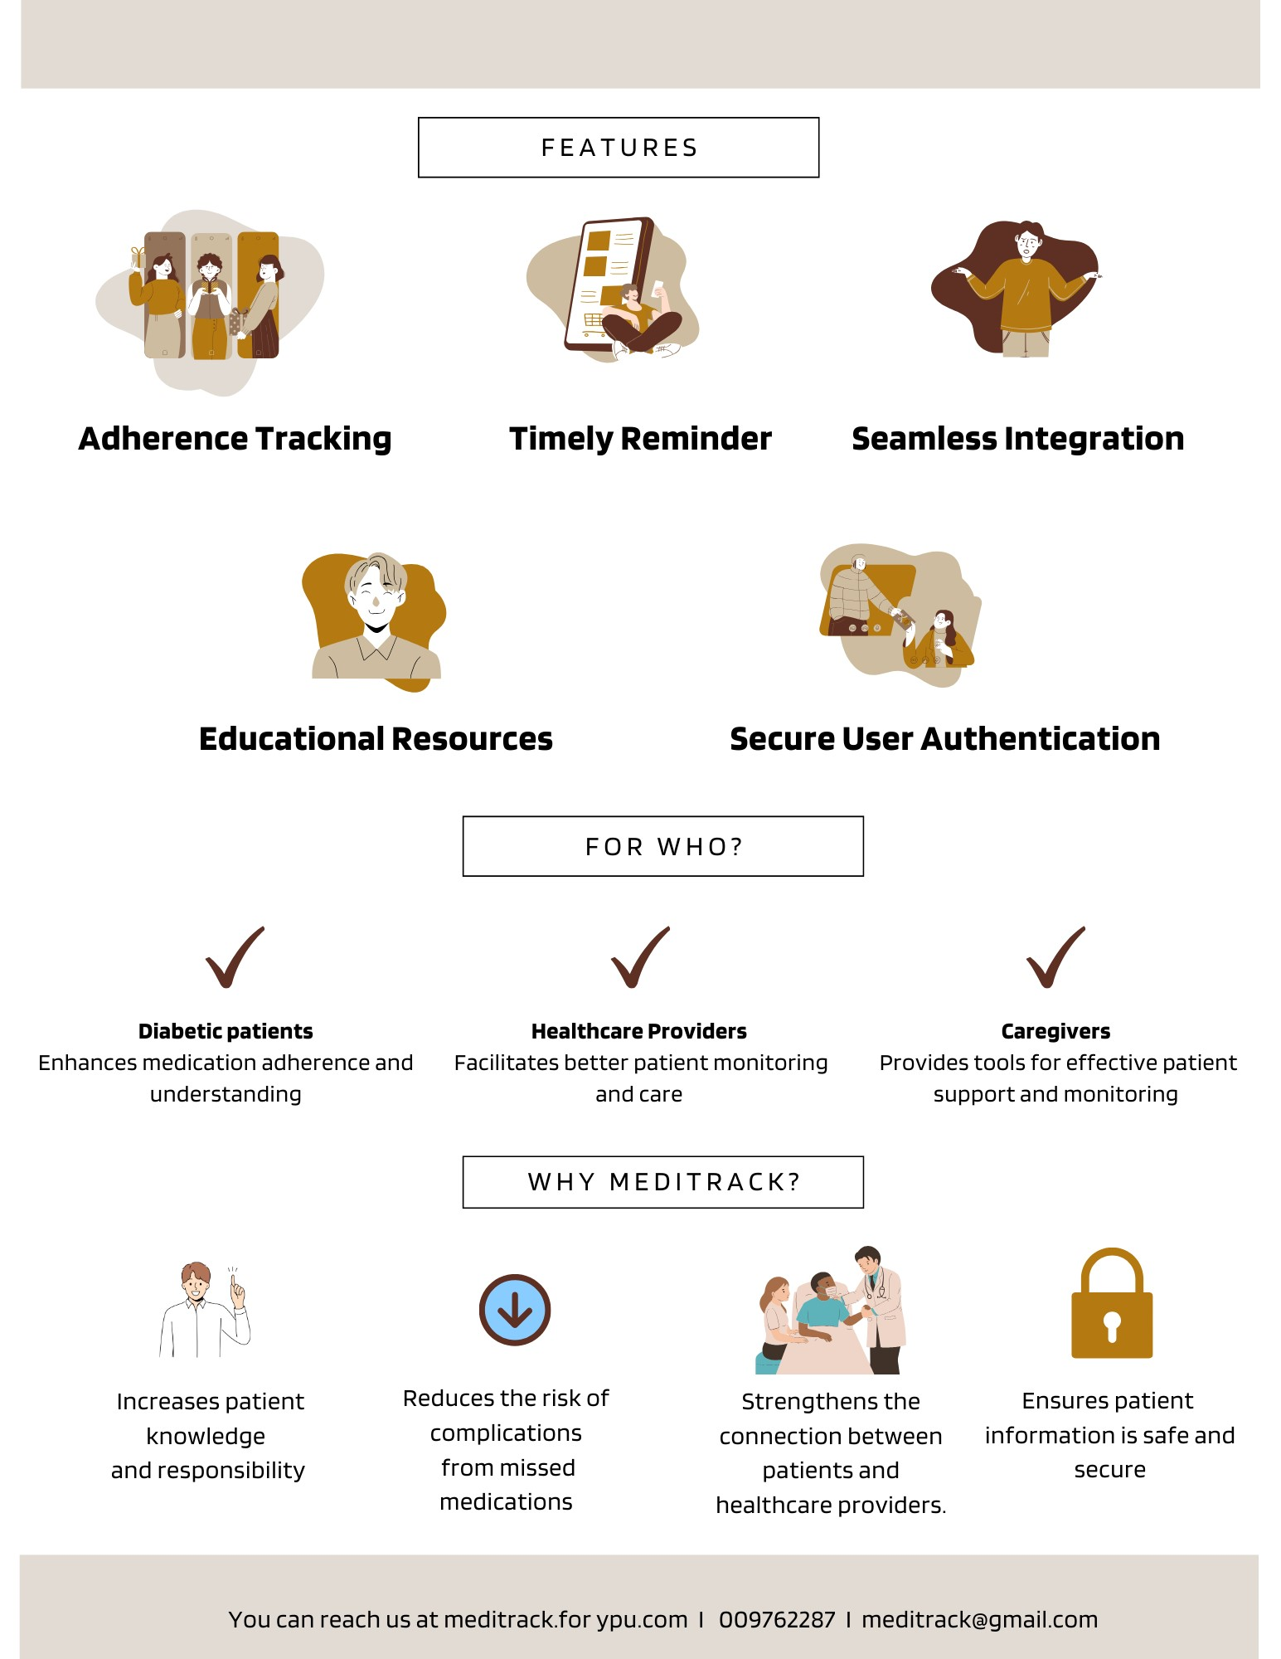
Front of the Package
Back of the Package

Slide 8
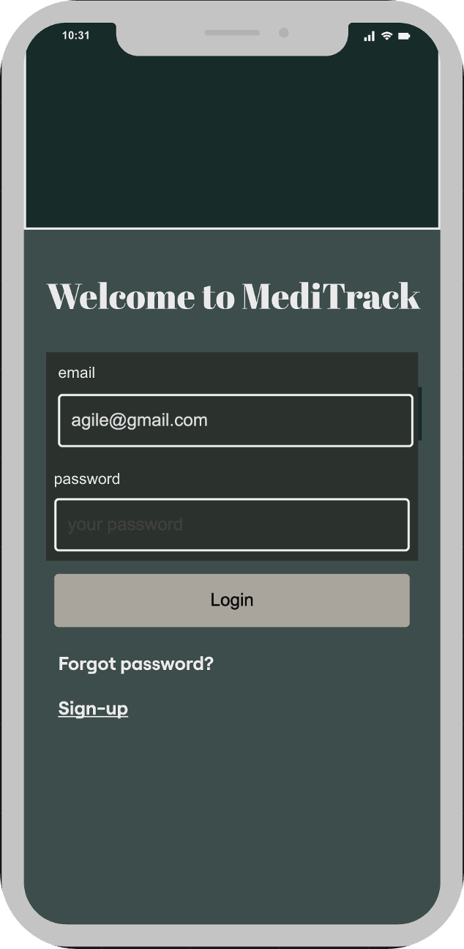
Elevator Speech
"Imagine a world where diabetic patients never miss a dose of their medication. Meet MediTrack, the ultimate medication adherence tool designed specifically for diabetic patients..."

Slide 9






Speculate Phase
Release Plan
Month 2:
Develop user authentication system
Month 4:
Create medication reminder system
Month 6:
Integrate educational materials and healthcare provider APIs
Month 1:
Draft backlog and early user stories
Month 3:
Implement drug schedule interface
Month 5:
Produce adherence reports and tracking features

Slide 10
Speculate Phase
2. Iteration Plan
Iteration Duration: 2 weeks
Planning: Choose user stories, allocate responsibilities, set goals and tasks
Development: Implement features, code reviews, ensure coding standards
Testing: Execute unit and integration tests, User Acceptance Testing (UAT)
Review & Retrospective: Showcase features, gather feedback, discuss improvements

Slide 11









Speculate Phase
3. Platform development and launch
Development phases
Launch
User authentication, profile management, medication schedule configuration
Adherence tracking, reminder system, educational materials
API integration, extensive testing and validation
Develop training materials
Conduct training sessions
Gather feedback from initial users
Final adjustments before full deployment

Slide 12

Speculate Phase
4. Story cards
Draft Backlog and Early User Stories
Develop User Authentication and Profile Management System
Interface for Setting Up Drug Schedules and Initial UAT
Develop Medication Reminder System and Comprehensive Testing
V-5
V-10
V-10
V-12
Produce Adherence Reports and Tracking Features
Integrate Drug Education Materials and Healthcare Provider APIs
Extensive UAT, Security, and Performance Testing
Training Sessions and Final Adjustments
V-8
V-10
V-10
V-10

Slide 13
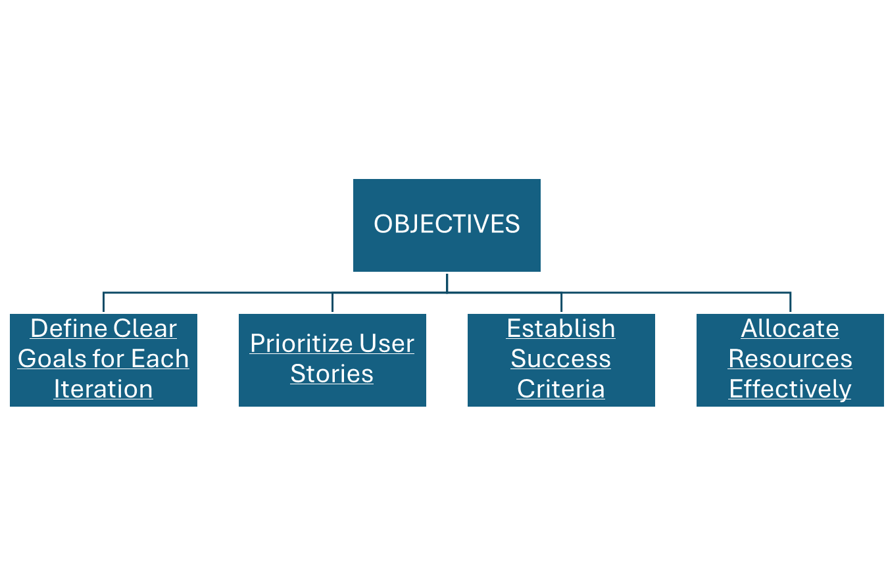
Iteration planning in the Medication Adherence Tool project involves organizing and scheduling the development work into manageable, time-boxed sprints, typically two weeks long. This iterative approach ensures that the project progresses steadily, allows for frequent reassessment, and incorporates user feedback continuously.
Explore Phase

Slide 14

Sprint 1 Planning Meeting
Date: June 1, 2024
Attendees: Project manager, Nilisha, Belen, Daria, Amrita, Persabel, Edet, Muskan.
Agenda:
Introduction to the project and objectives
Discuss user stories related to user authentication and profile creation
Estimate tasks and assign them to team members
Discussion:
Project Introduction: Overview of the MediTrack project, its purpose, and goals. Emphasis on the importance of secure and reliable user authentication and profile creation.
User Stories:
As a user, I want to create a secure account to save my medication data.
As a user, I want to log in with my credentials to access my profile.
Task Estimation:
Task 1: Design user registration form (4 hours)
Task 2: Implement backend for user registration (6 hours)
Task 3: Design user login form (4 hours)
Task 4: Implement backend for user login (6 hours)
Task Assignment:
Muskan: Design user registration and login forms
Belen: Implement backend for user registration
Daria: Implement backend for user login
Decisions:
Approved user stories for user authentication and profile creation.
Task assignments finalized.

Slide 15

Daily Stand-up Meetings
Daily Stand-up Meeting (June 2, 2024)
Date: June 2, 2024
Attendees: Project Manager, Nilisha, Belen, Daria, Amrita, Persabel, Edet, Muskan
Agenda:
What was done yesterday?
What will be done today?
Any impediments/blockers?
Updates:
Project Manager: Reviewed project objectives and coordinated with team members. Today, we will monitor the progress and assist with any blockers.
Muskan: Completed the initial design for the user registration form. Today, we will finalize the design and start on the user login form.
Belen: Set up the project repository and database schema. Today, we will start coding the backend for user registration.
Daria: Researched API integration methods. Today, we will begin implementing the backend for user login.
Impediments:
Daria: Encountered difficulties with API authentication. Needs support from Belen.
Next Steps:
Project Manager: Continue project oversight and provide assistance as needed.
Muskan: Complete design tasks and move to login form design.
Belen: Assist Daria with API authentication and continue backend development.
Daria: Resolve API issues with help from Belen and continue backend implementation.

Slide 16
Date: June 7, 2024
Attendees: Project Manager, Nilisha, Belen, Daria, Amrita, Persabel, Edet, Muskan, Stakeholders
Agenda:
Demonstration of completed work
Feedback from stakeholders
Discussion:
Demo: Presented the user authentication and profile creation features. Showed the user registration and login process.
Feedback:
Positive response to the secure and efficient user authentication.
Suggestions for improvement: Add password recovery option and enhance user profile UI.
Decisions:
Decided to add a password recovery feature in the next sprint.
Enhance the user profile UI based on feedback.
Action Items:
to design the password recovery UI.
to implement the password recovery backend.
to improve the user profile UI.
Sprint 1 Review Meeting

Slide 17
Sprint 1 Retrospective Meeting
Date: June 7, 2024
Attendees: Project Manager,Nilisha, Belen, Daria, Amrita, Persabel, Edet, Muskan
Agenda:
What went well
What didn’t go well
Improvements for the next sprint
Discussion:
What Went Well:
Successful implementation of user authentication and profile creation.
Strong team collaboration and communication.
What Didn’t Go Well:
Encountered API integration issues, causing minor delays.
Improvements:
Plan for more detailed technical reviews before starting implementation.
Increase frequency of team check-ins to identify and resolve issues early.
Decisions:
Agreed to conduct a dedicated technical review session before each sprint.
Increase daily stand-up meeting duration to allow for more thorough updates.
Action Items:
to schedule and lead technical review sessions.
to document API integration processes and share with the team.
to monitor daily stand-up meetings and ensure all issues are addressed.

Slide 18
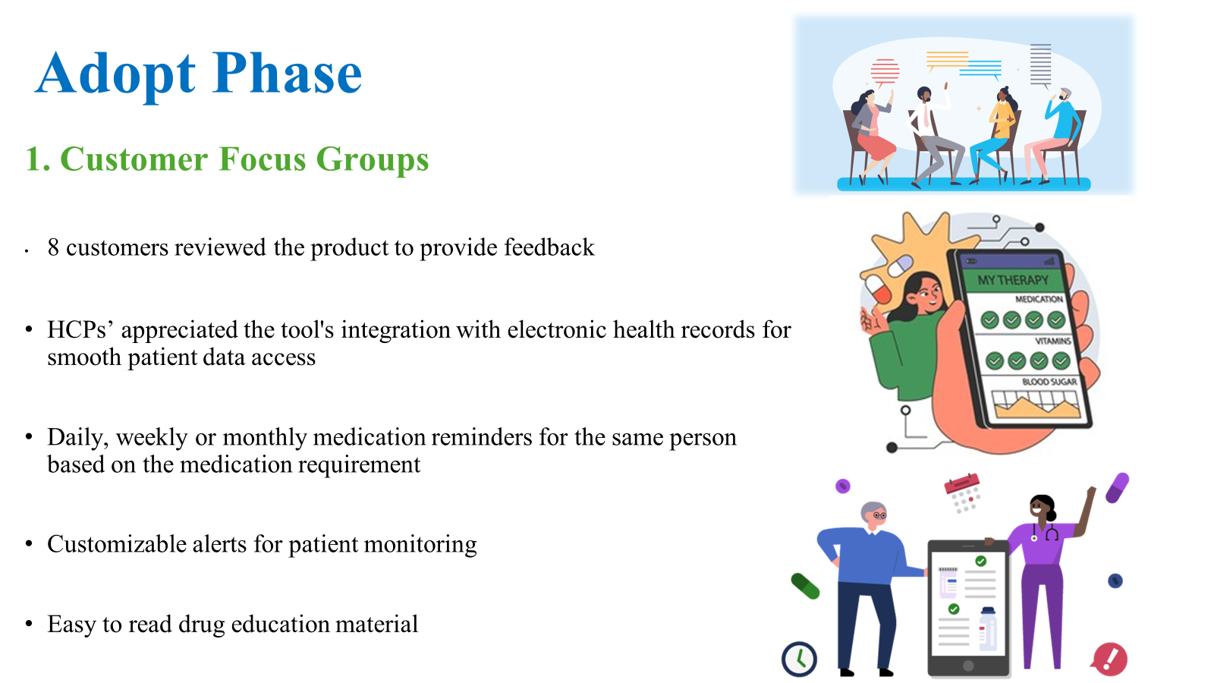

Slide 19
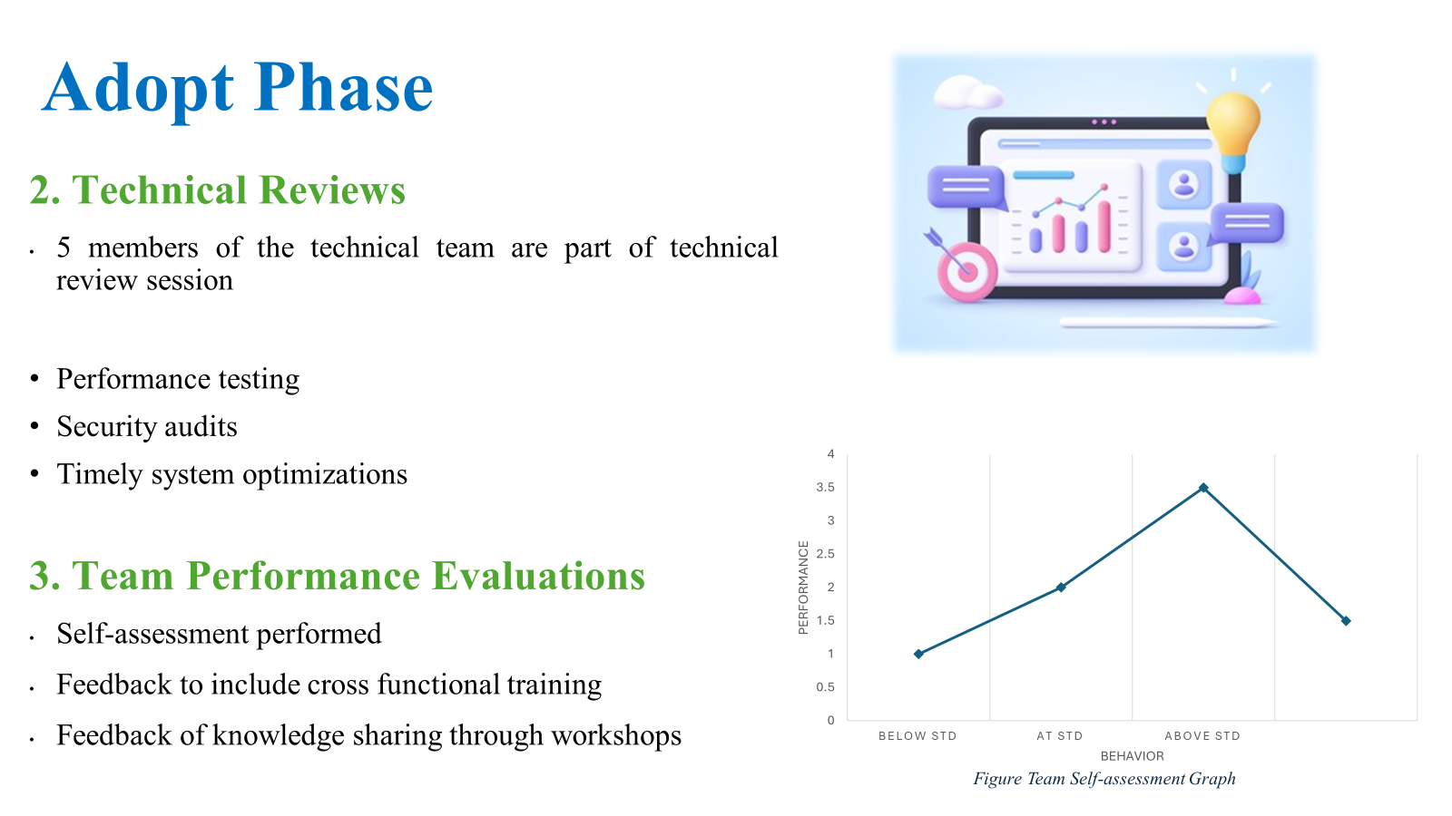

Slide 20
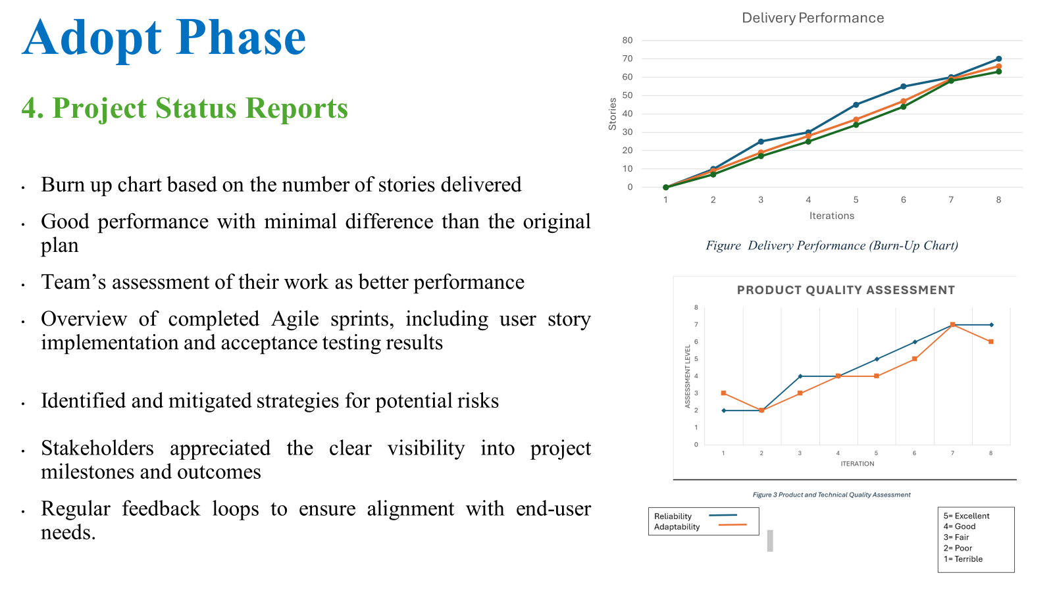

Slide 21
Close Phase
Final Deliverables
Documentation: User manuals, technical specs, implementation guides
Project Report: Lifecycle coverage, challenges, mitigation strategies
User Manual: Step-by-step instructions with screenshots and tips
Technical Documentation: System architecture and API documentation
Achievements
Successful execution of iterative development phases
Enhanced user interface based on feedback
Scalable, reliable, and secure tool meeting industry standards

Slide 22
Close Phase (Persabel Tesfay)
Evaluations, Lessons learned, & Future Planning
Evaluations
Customer Focus Groups: Key insights leading to UI and functionality improvements
Technical Reviews: Scalability, reliability, and security standards met
Lessons Learned
Agile Methodology: Continuous feedback improved tool quality
Stakeholder Engagement: Clear communication was vital for aligning expectations
Closure Activities
Meetings: Final meetings to discuss progress and next steps
Documentation Handover: Delivered all project materials to stakeholders
Post-Project Activities
User Training: Sessions for patients, caregivers, and healthcare providers
Monitoring & Maintenance: Ongoing performance monitoring and updates
Future Planning
Feedback Loop: Establishing continuous user feedback channels
Development Roadmap: Planning future features and enhancements based on feedback

Slide 23
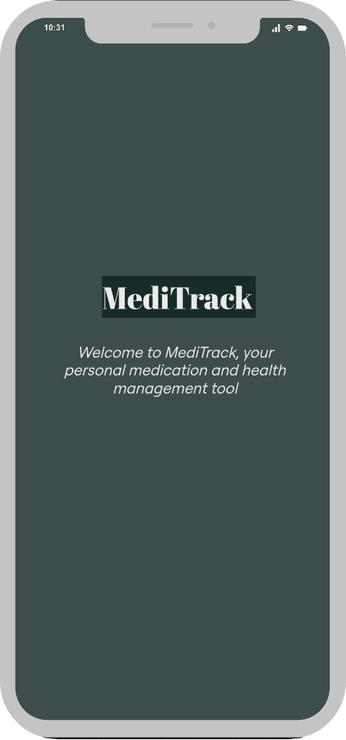
Close Phase
Prototype

Slide 24
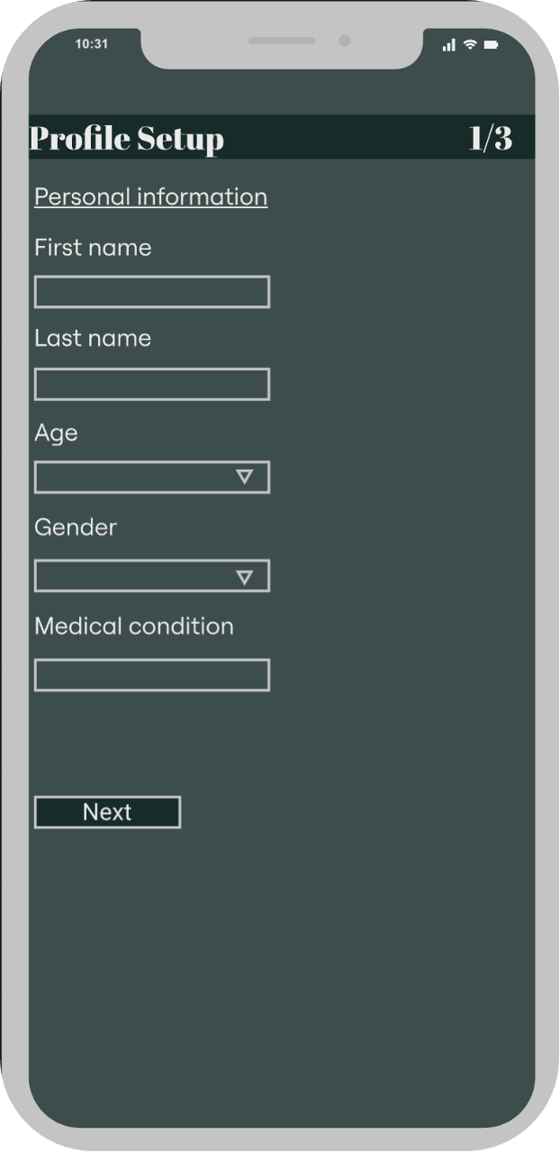
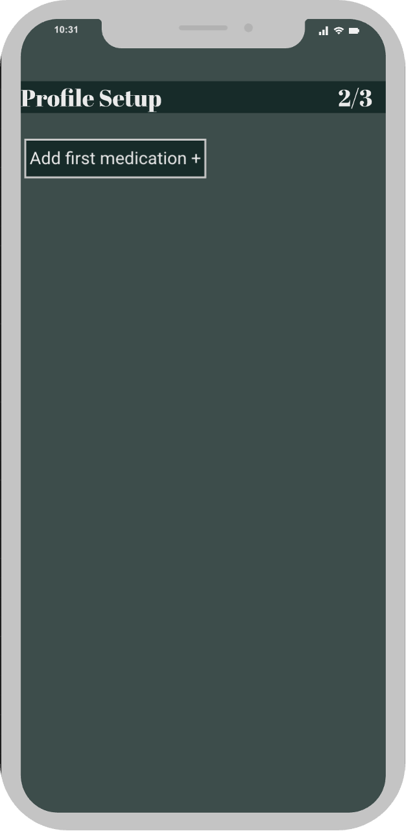
Close Phase
Prototype

Slide 25
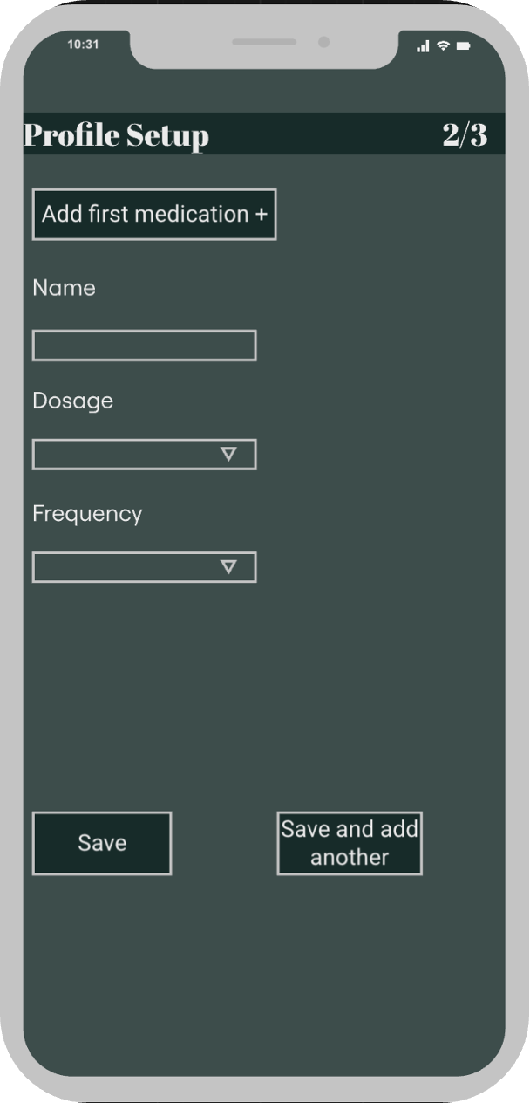
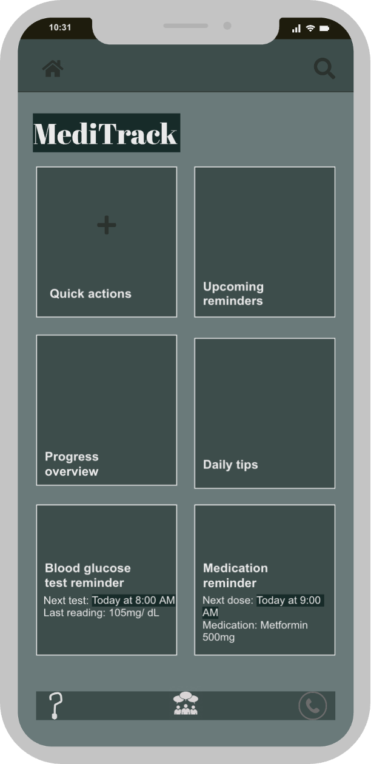
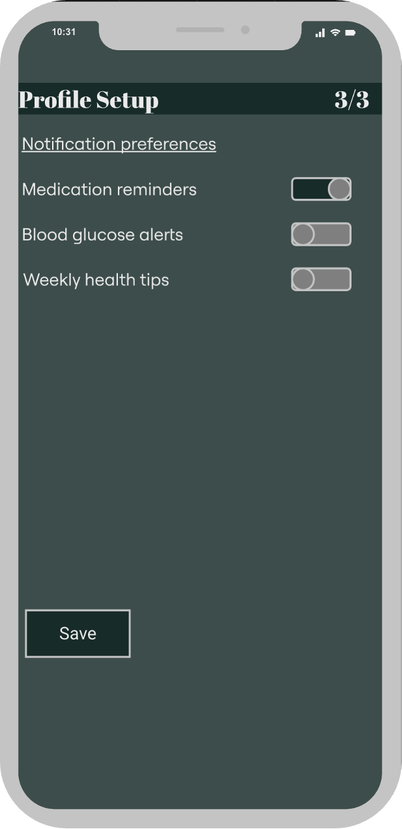
Close Phase
Prototype

Slide 26
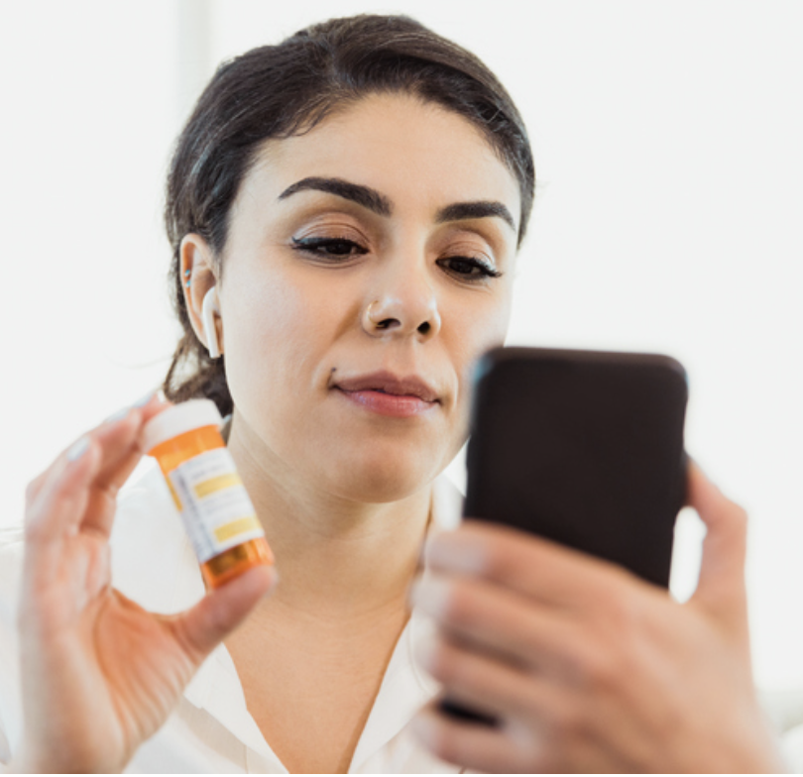
Conclusion
MediTrack will be:
Effective medication management
Prompt reminders
Seamless interaction with healthcare systems

